Slide 1

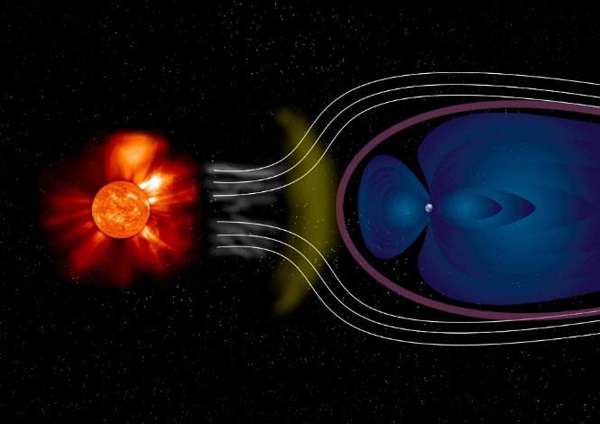
Electromagnetics
# 1
G. M. Parsanasab
References:
[1] David J. Griffiths, Introduction to Electrodynamics-Cambridge University Press (2017).
[2] Cheng, David Keun, Field and wave electromagnetics-Pearson New international ed. (2013_2014).
[3] Purcell E.M., Morin D.J. - Electricity and Magnetism-Cambridge University Press (2013).
[4] Jr. George Brinton Thomas, Christopher Heil, Joel Hass, Przemyslaw Bogacki, Maurice D. Weir, University calculus, early transcendentals (2020).

Slide 2
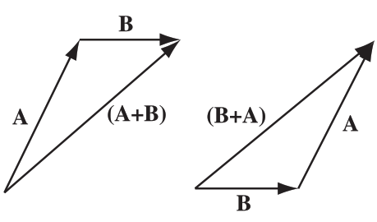
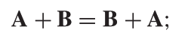
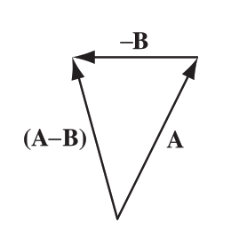
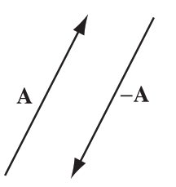
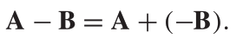
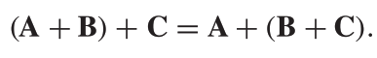
C H A P T E R 1 :Vector Analysis
1.1 VECTOR ALGEBRA

Slide 3
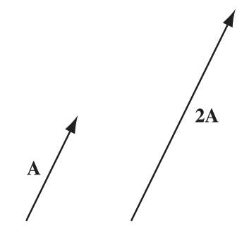
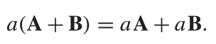
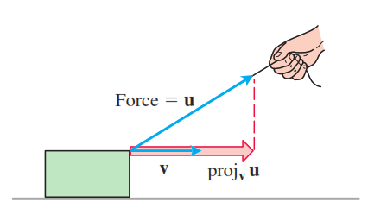
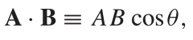
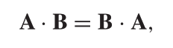
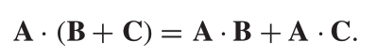
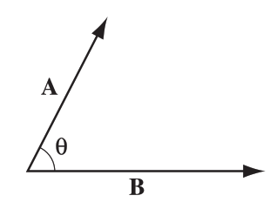
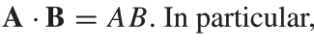
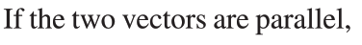
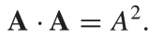
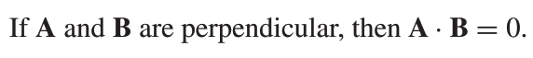
Multiplication by a scalar
Dot product of two vectors

Slide 4
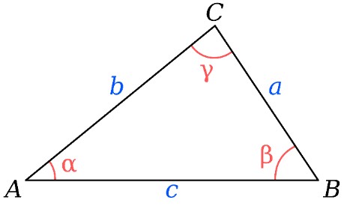
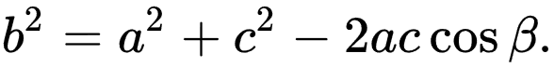
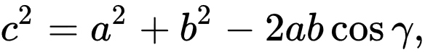
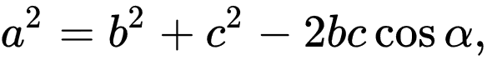
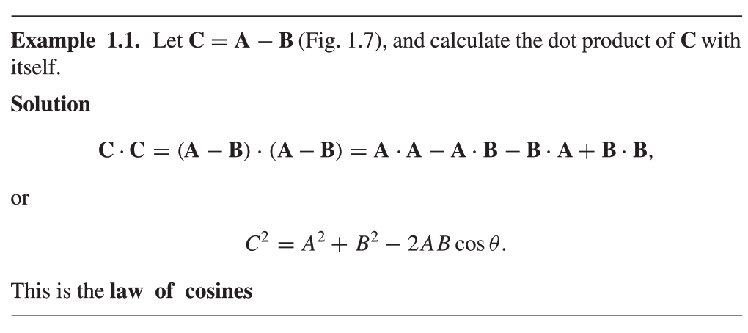

Slide 5
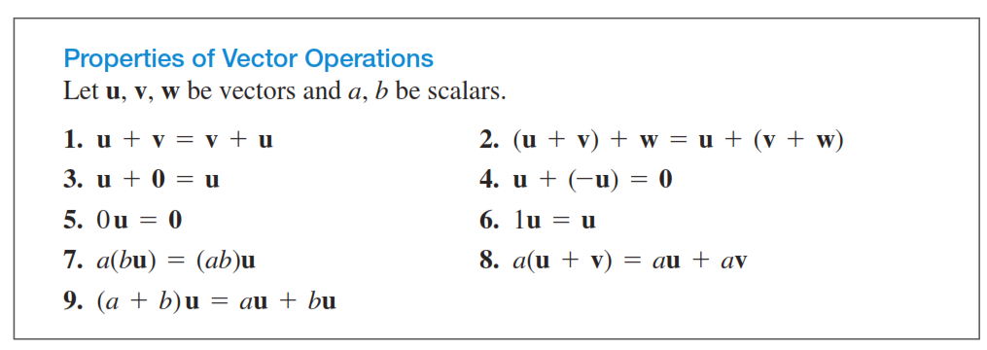
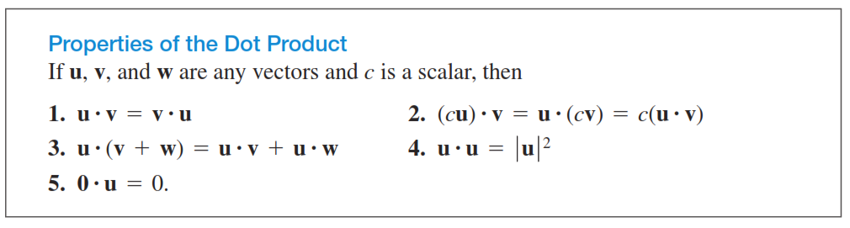

Slide 6
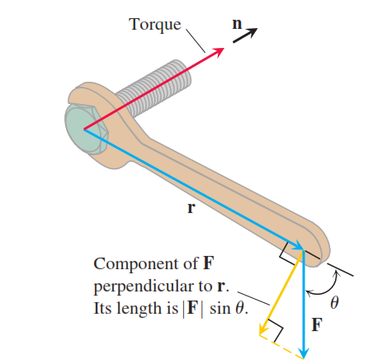

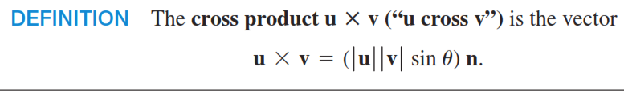
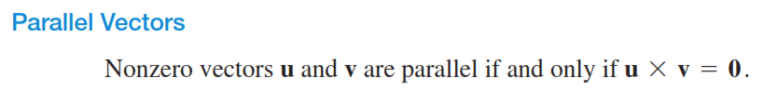
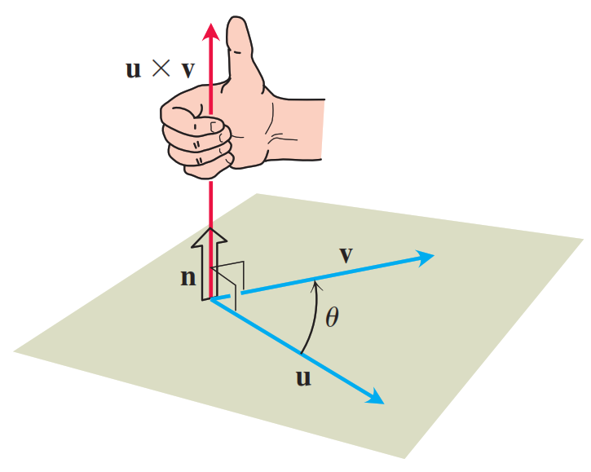

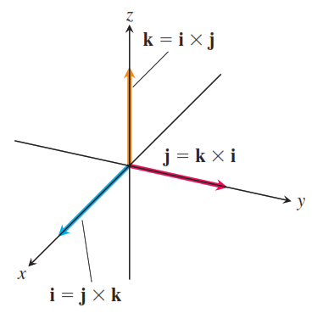
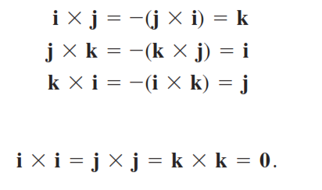
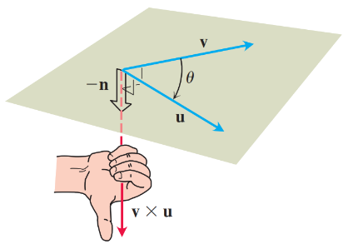
Cross product of two vectors

Slide 7
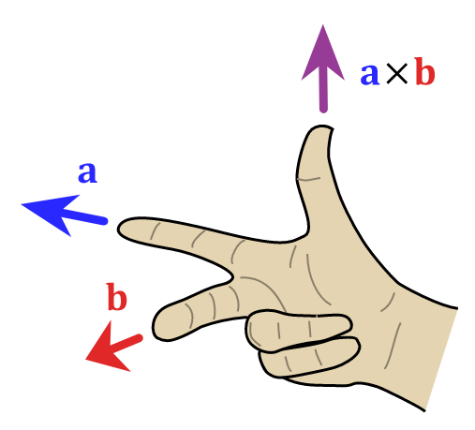

Slide 8
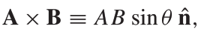
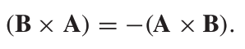
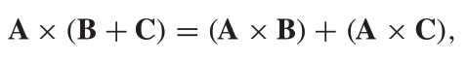
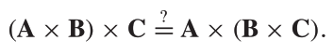

Slide 9
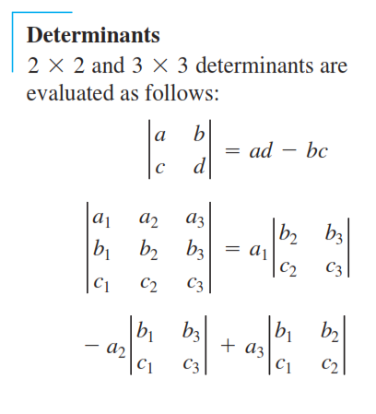
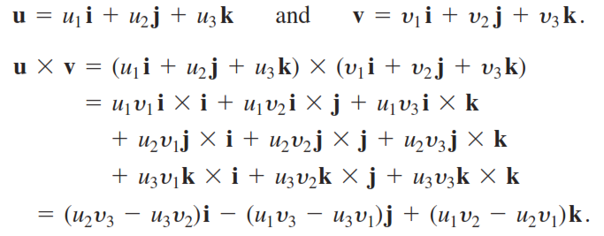
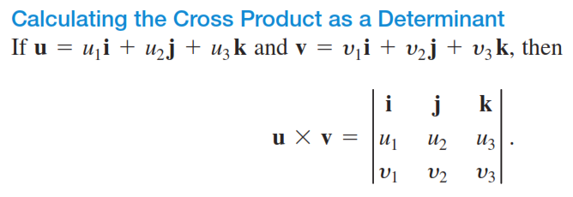

Slide 10
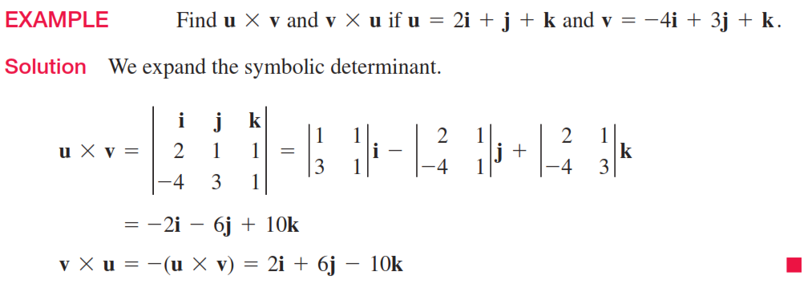
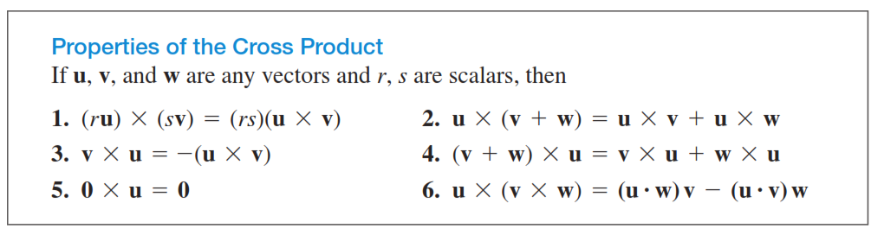

Slide 11
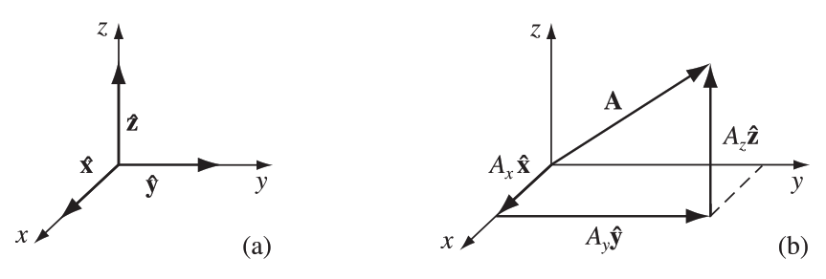
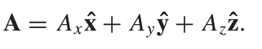
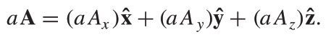
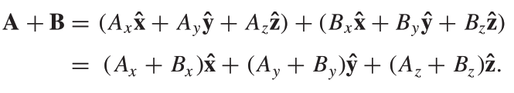
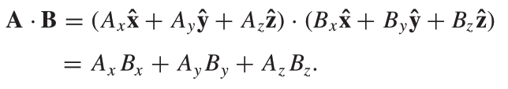
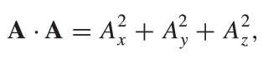
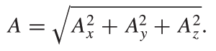
Vector Algebra: Component Form

Slide 12
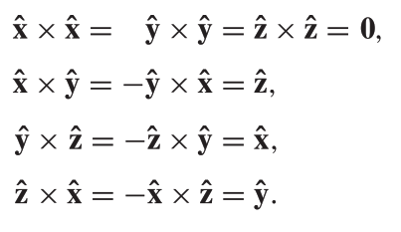



Slide 13


Of course, you can get the answer more easily by drawing in a diagonal across
the top of the cube, completing the equilateral triangle. But in cases where the
geometry is not so simple, this device of comparing the abstract and component
forms of the dot product can be a very efficient means of finding angles.

Slide 14



Triple Products
The parallelogram determined by u and v.

Slide 15





Slide 16
Vector triple product (BAC-CAB rule):

Slide 17


For more info:
https://www.stumblingrobot.com/2016/05/05/prove-vector-identities-using-cab-minus-bac-formula/

Slide 18



Simplifying Vector Expressions
a) Kronecker delta
b) Einstein summation convention
Einstein summation is a notational convention for simplifying expressions including summations of vectors, matrices:
Repeated indices are implicitly summed over

Slide 19



c) Levi-Civita symbol
Einstein Notation

Slide 20
Dot product of two vectors
Cross product of two vectors

Slide 21
Triple scalar product

Slide 22
Triple cross product: The “bac-cab” rule.
Problem: Prove the expressions below, using Einstein notation, Kronecker and c) Levi-Civita symbols.

Slide 23


1) Functions of Several Variables
Functions of Two Variables:
The graph and selected level curves of the function ƒ(x, y).
The level curves lie in the xy-plane, which is the domain of the function ƒ(x, y).

Slide 24





Contour plot

Slide 25



Functions of Three Variables

Slide 26



Slide 27





Slide 28











2) vector-valued function
Curves in Space
The position vector of a particle moving through space is a function of time.

Slide 29







Vector Fields

Slide 30








Position, Displacement, and Separation Vectors
infinitesimal displacement vector
separation vector

Slide 31




How Vectors Transform

Slide 32






Slide 33





Slide 34




Slide 35







A vector is any set of three components that transforms in the same manner as a displacement when you change coordinates.
As always, displacement is the model for the behavior of all vectors.
A
Do the components of B transform? Of course not.
it doesn’t matter what coordinates you use to represent positions in space;
There are still just as many apples in the barrel. You can’t convert a apple into a banana by choosing a different set of axes, but you can turn Ax into Ay .
B

Slide 36

Tensors
Rank0 rank1 rank2 rank3
2D space
Rank0 rank1 rank2 rank3
3D space

Slide 37



Tensors Transformation
An nth-rank tensor has n indices and 3^n components, and transforms with n factors of R. In this hierarchy, a vector is a tensor of rank 1, and a scalar is a tensor of rank zero.
(second-rank) tensor is a quantity with nine components, Txx , Txy , Txz , Tyx , . . . , Tzz , which transform with two factors of R. (?)

